Slide 1

: VietNamita Hacker

Slide 2

TEAM’S MEMBER
NGUYEN TUAN MANH-THIRD YEAR STUDENT
PHAM GIA KHIEM-SECOND YEAR STUDENT
BUI HOANG MINH-FIRST YEAR STUDENT

Slide 3






VietNamita Hacker
IDATAHACK
RESULT

Slide 4

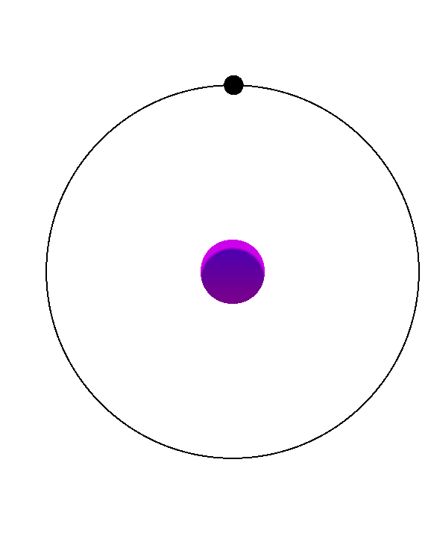
VietNamita Hacker
UNDERSTANDING DATA
In this IDATAHACK challenge, participants are provided with a comprehensive dataset comprising 2,056,160 rows and 44 columns,
The dataset is centered around customer interactions with various banking products and services, making it an excellent resource for advanced modeling of customer behavior and engagement. The goal is to build a predictive model that determines whether a customer will repay their debt.

Slide 5
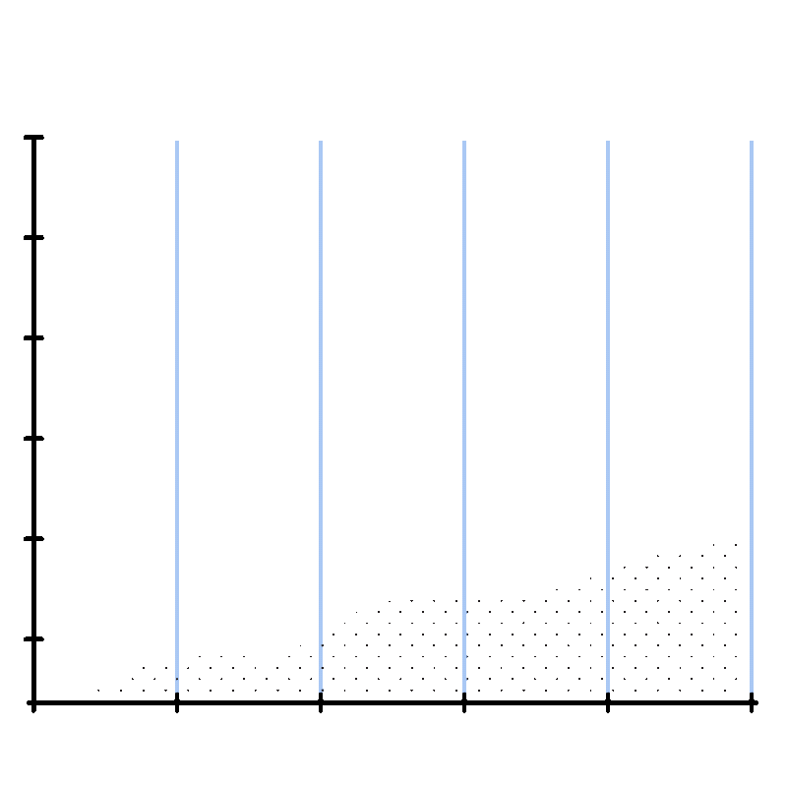
EXPLORATORY
DATA ANALYSIS

Slide 6
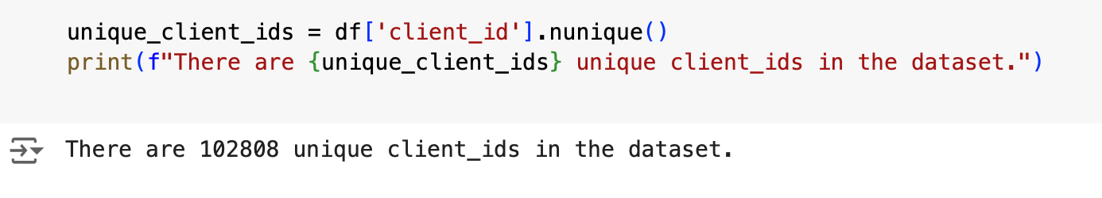
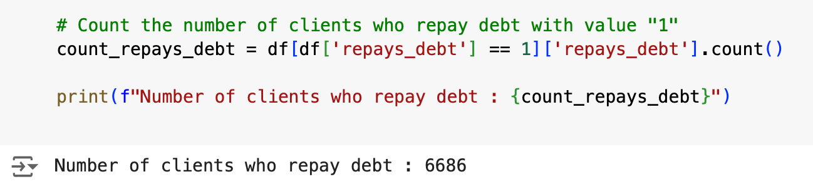
Let’s understand our dataset

Slide 7
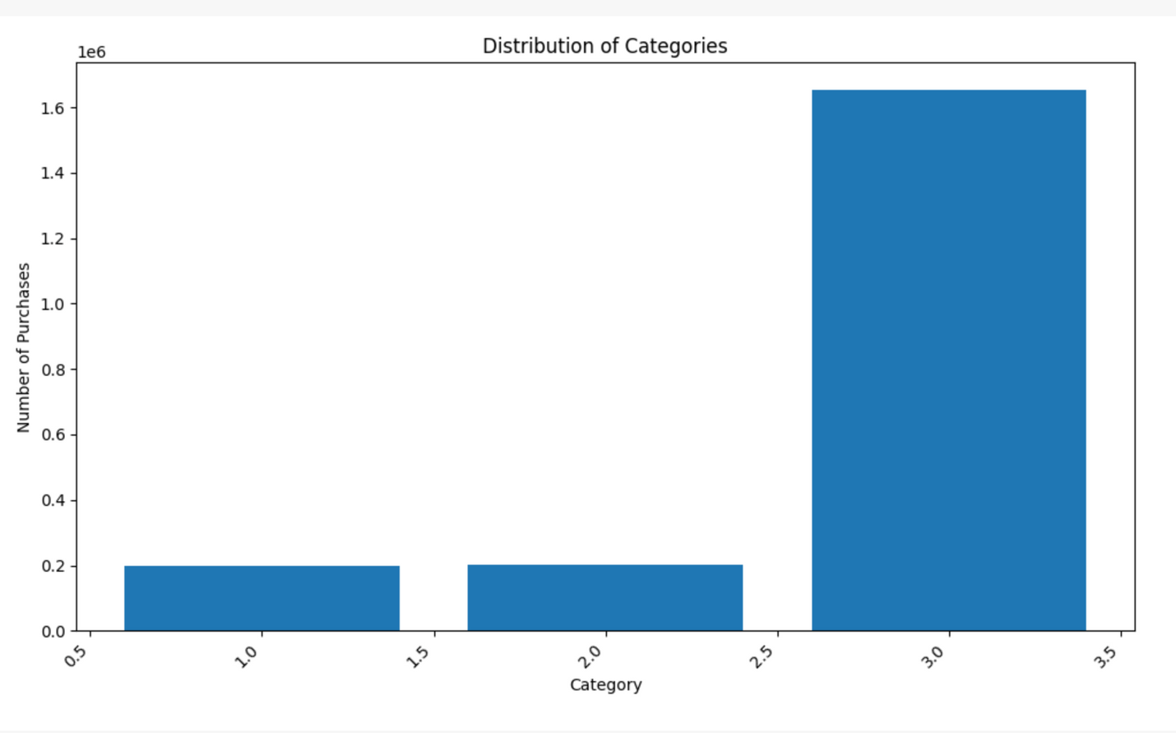
Let’s understand our dataset

Slide 8
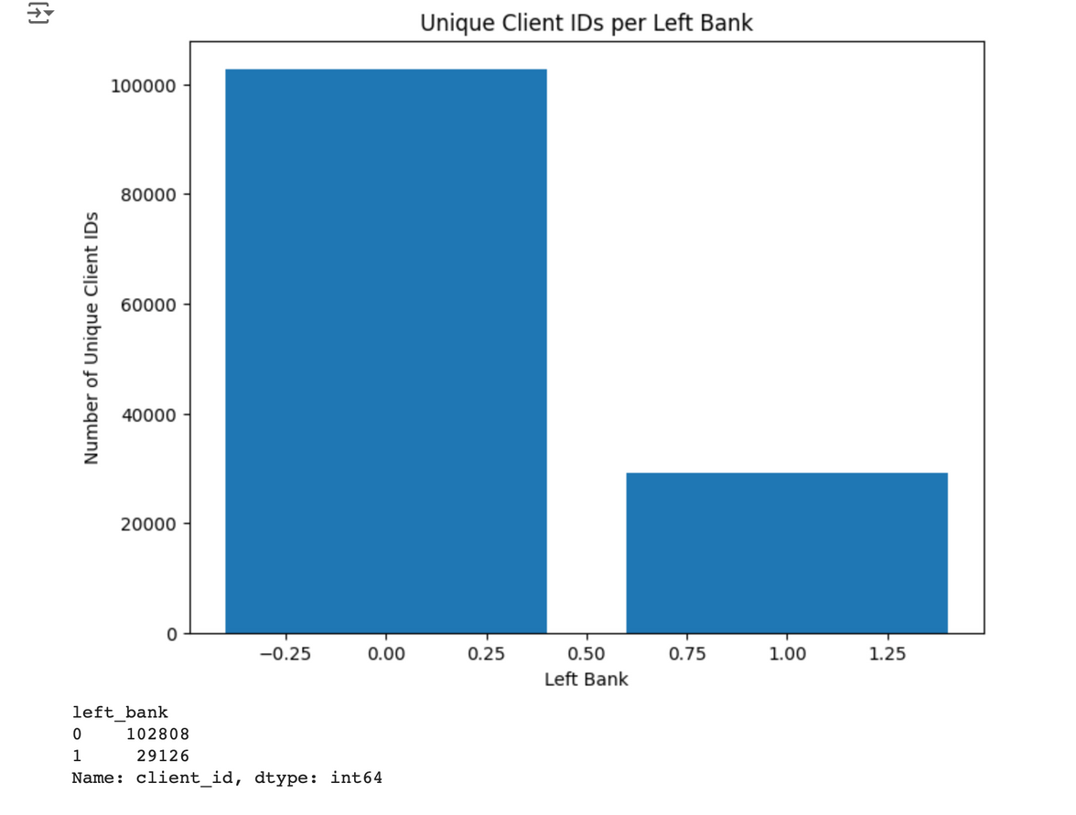
Let’s understand our dataset

Slide 9
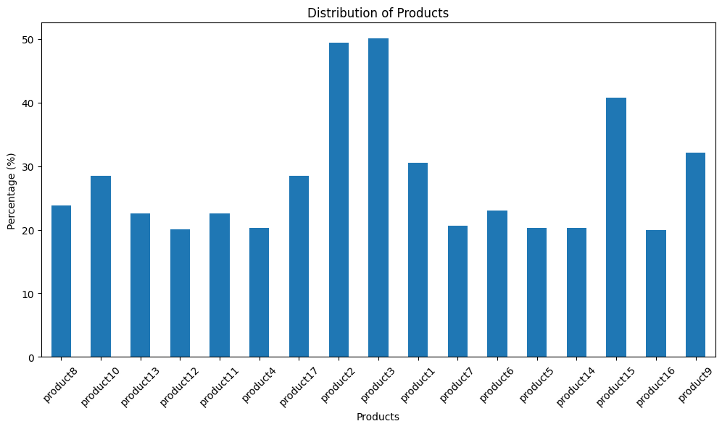
Distribution of Product ownership

Slide 10
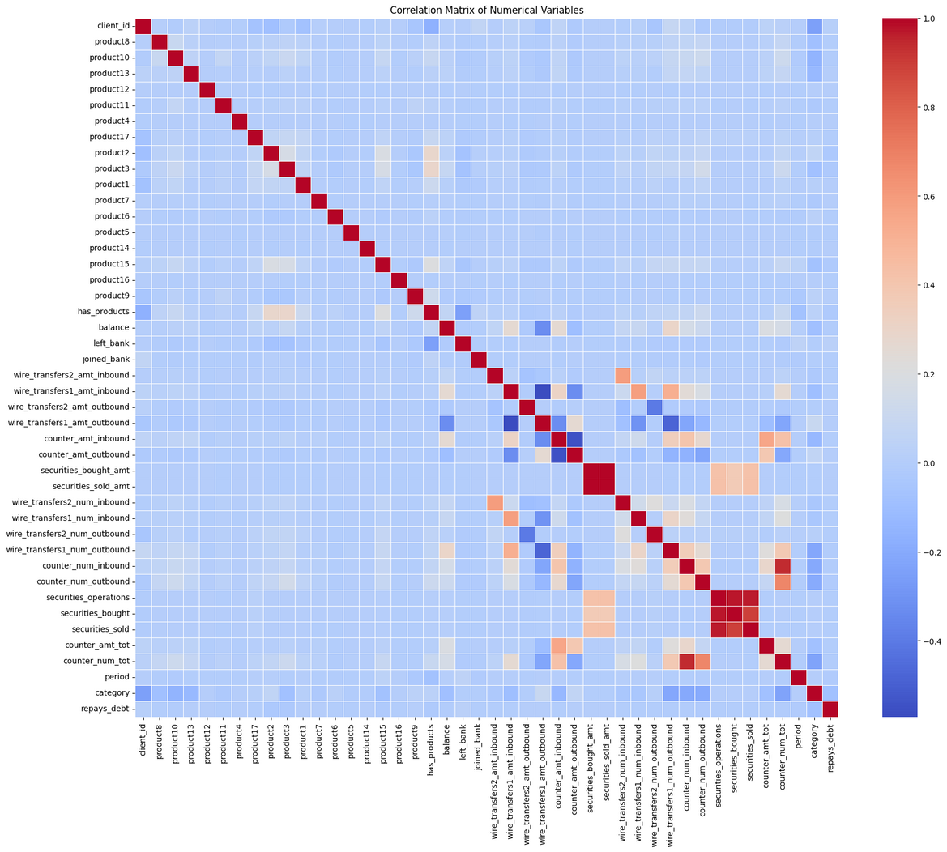
Heatmap
Colerration Matrix
Most variables show weak correlations with each other, indicating correlation values close to 0. This suggests that many variables in the dataset are either independent or have minimal linear relationships.
There are some noticeable positive correlations (red areas) among the wire transfer variables and counter-transaction variables.
For example, the amount and number of inbound and outbound transactions tend to be positively correlated with each other.

Slide 11
VietNamita Hacker
Because of the imbalance of the dataset, we have to use different methods such as Undersampling and Oversampling to ensure the models run smoothly without any trouble.
To be more specific, with the use of the Undersampling method, we balanced the class distribution with 1: 6686 values and 0: 2049274 which are heavily unbalanced values.
We took the 6686 values of 1 and took that amount from 0 to make them equal to each other with a 6686 value of 1 and a 6686 value of 0
KEY
CONCEPTS

Slide 12

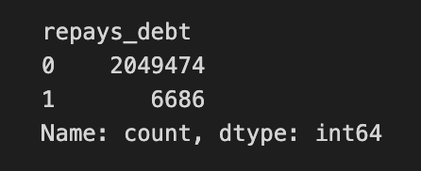
VietNamita Hacker
UNDERSAMPLING

Slide 13
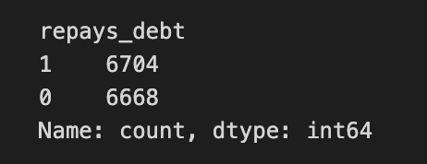
VietNamita Hacker
UNDERSAMPLING

Slide 14
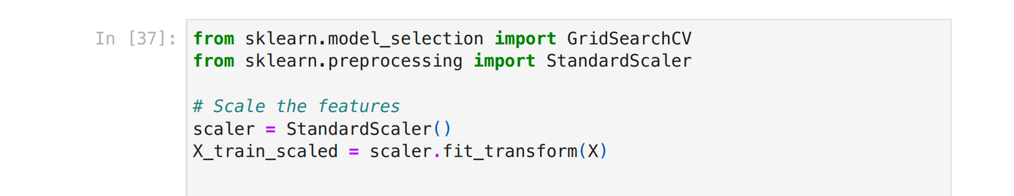
DATA NORMALIZATION

Slide 15

VietNamita Hacker
MACHINE LEARNING
MODELS
We initially used Logistic Regression, achieving an expected F1 score of 0.66 to 0.70.
After experimenting with models like Support Vector Machines and Neural Networks, we struggled due to limited experience.
Finally, the Random Forest model delivered a significantly higher F1 score on our test data.

Slide 16
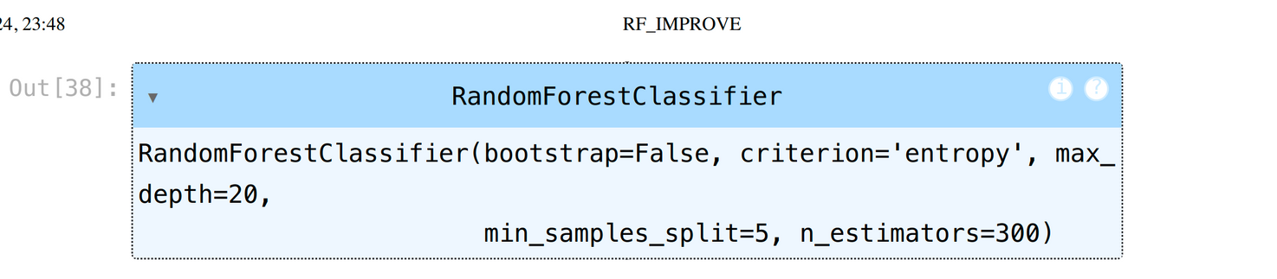
Model Tuning Parametter

Slide 17
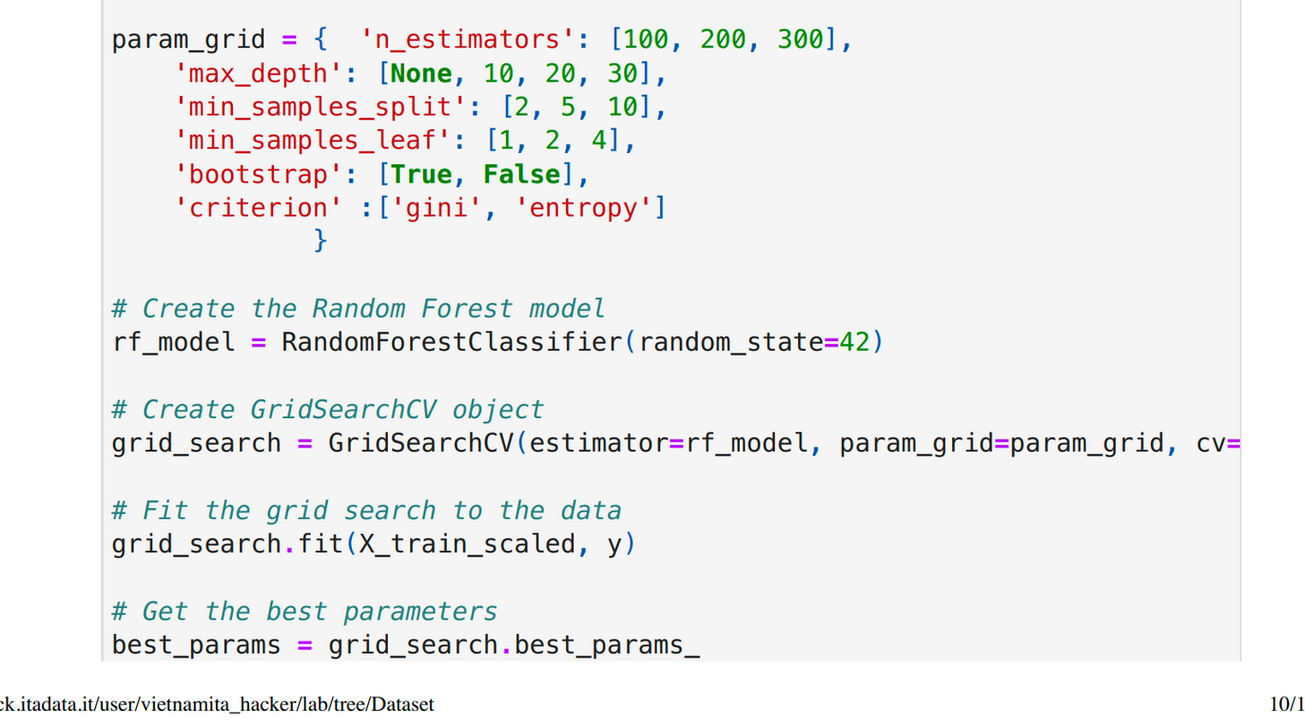

Slide 18
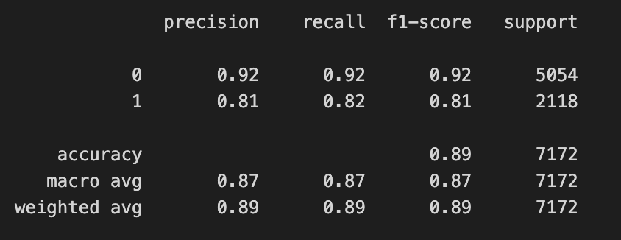
VietNamita Hacker
MODEL RESULT (RF)

Slide 19
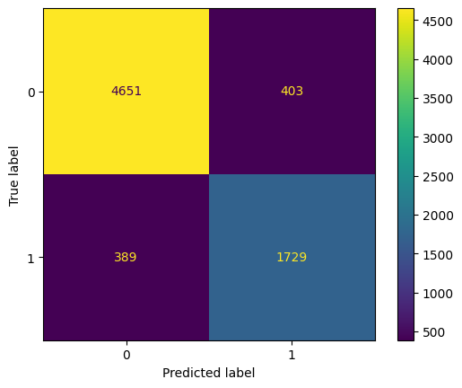
CONFUSION
MATRIX
The model has made a significant number of correct predictions, with 4651 true negatives (TN) and 1729 true positives (TP). This suggests that the model is generally performing well in distinguishing between the two classes.
The model has a balanced performance, with a relatively similar number of false positives (403) and false negatives (389). This suggests the model isn’t strongly biased toward one class.

Slide 20
VietNamita Hacker
THANK YOU!

